Slide 1
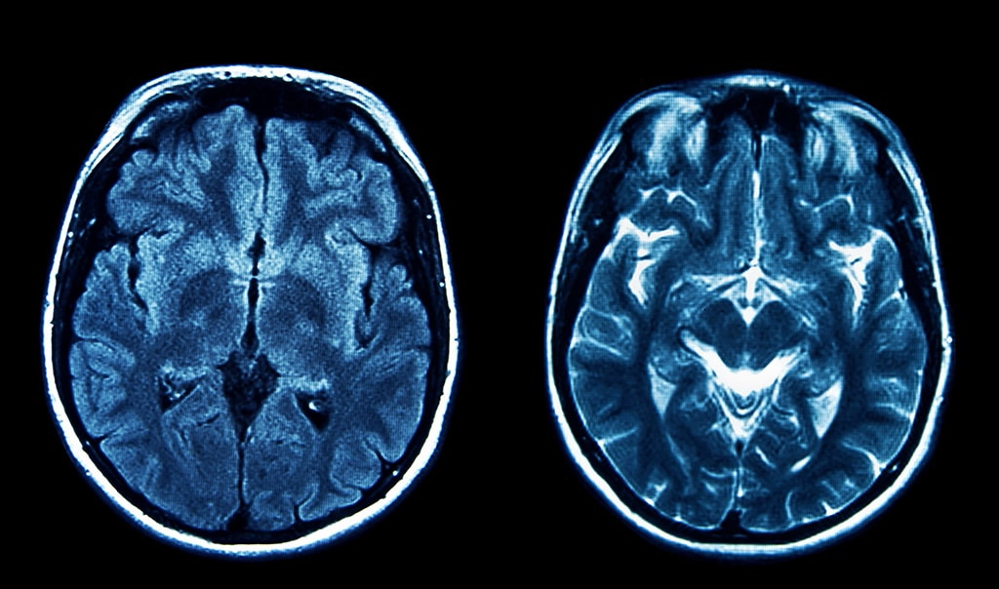
ICE-478 COURSE PROJECT
Brain Cancer MRI
Classification
Comparative Analysis of Supervised and
Semi-Supervised Learning Methods
2026
44 Tumor Classes
Deep Learning & SSL

Slide 2
Table of Contents
01
Dataset Overview
02
Related Work
Brain Cancer MRI dataset with 44 distinct tumor classes, data characteristics, and preprocessing pipeline
Review of recent advances in brain tumor classification using deep learning and machine learning approaches
03
Supervised Methods
04
Semi-Supervised Learning
Model training, evaluation metrics (Accuracy, Precision, Recall, F1-score), and train-test ratio analysis
SimCLR framework, contrastive learning, and SSL performance across different labeled data ratios
05
Performance Comparison
06
Model Evaluation & Visualization
Best SSL model learning curves, best supervised model analysis, and comparative evaluation
t-SNE feature space analysis, cluster visualization, and conclusions for clinical applications

Slide 3
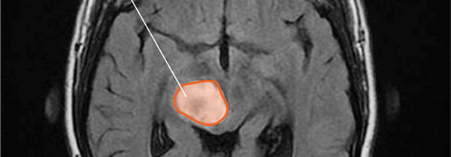
DATASET CHARACTERISTICS
Brain Cancer MRI Images
Dataset Statistics
44
MRI
Tumor Classes
Image Modality
Labeled
Multi
Brain MRI scan with tumor region highlighted
Dataset Type
Classification
Data Preprocessing
Sample Tumor Types
Image resizing and normalization
Astrocitoma T1
Astrocitoma T1C+
Data augmentation (rotation, flip, contrast)
Astrocitoma T2
Carcinoma T1
Class label encoding and verification
Carcinoma T1C+
Carcinoma T2
Train-test split with stratification
Ependimoma T1
+ 37 more classes

Slide 4
LITERATURE REVIEW
Related Work in Brain Tumor Classification
Deep Learning Approaches
Machine Learning Methods
ResNet50 (Optimized)
99.69%
Random Committee (RC)
98.61%
Custom classifier with BatchNorm and Dropout (0.4) for 4-class classification
Correlation-based feature optimization with 11 key features
Xception Model
98.73%
Ensemble DNN-SVM
97.93%
Weighted accuracy with exceptional generalization capabilities
Median filtering, GLCM features, FCM segmentation
EfficientNetB7 (CPEB7)
98.97%
Custom Lightweight CNN
99.54%
Customized layers with fine-grained hyperparameter tuning
4×4 convolution kernel, 1.8M parameters, 6.89MB model size
Key Research Trends
Transfer Learning
Feature Fusion
Class Imbalance
SSL Methods
Pre-trained models fine-tuned
Multi-scale feature extraction
Handling 44 tumor classes
Semi-supervised learning

Slide 5
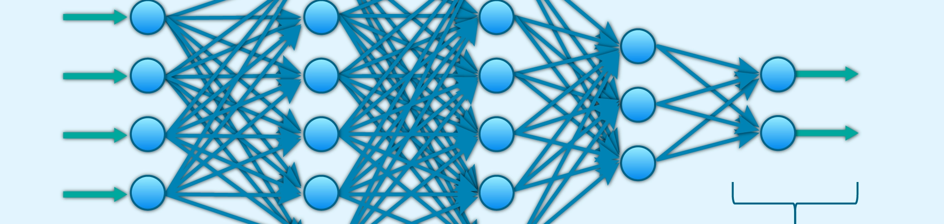
SUPERVISED APPROACH
Supervised Learning: Model Training & Evaluation
Model Architecture
Evaluation Metrics
Accuracy
Precision
Overall correct predictions
True positives / All positives
CNN backbone (ResNet/EfficientNet)
Recall
F1-Score
Global Average Pooling layer
True positives / Actual positives
Harmonic mean of P & R
Fully connected classifier (44 classes)
Softmax activation for multi-class
Train-Test Ratios
Training Configuration
90:10
90% Training
Optimizer
Learning Rate
10% Testing
Adam
0.0001
80:20
80% Training
Batch Size
Loss Function
20% Testing
32-64
Cross-Entropy
70:30
70% Training
30% Testing

Slide 6
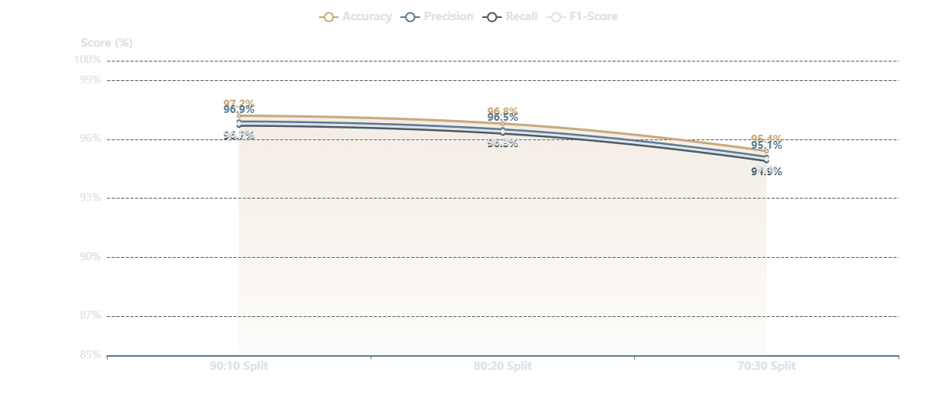
PERFORMANCE ANALYSIS
Supervised Learning: Performance Results

Slide 7
SSL FRAMEWORK
Semi-Supervised Learning: SimCLR Approach
SimCLR Methodology
Training Pipeline
1
Data Augmentation
Phase 1: Self-Supervised Pretraining
Create two augmented views of the same image using random crop, color jitter, Gaussian blur
2
Encoder Network
Train encoder on unlabeled data using contrastive learning
CNN backbone (ResNet) extracts feature representations from augmented views
800+ epochs
Batch size: 256+
3
Projection Head
Maps features to lower-dimensional space for contrastive learning
4
Contrastive Loss (NT-Xent)
Phase 2: Fine-tuning
Maximizes agreement between positive pairs, minimizes for negative pairs
Train classification head on limited labeled data
Frozen encoder
L2 regularization
Key Advantages
No labeled data required during pretraining
Learns meaningful representations from unlabeled data
Phase 3: Evaluation
Fine-tuning with minimal labeled data
Test on held-out test set with full metrics
Large batch sizes improve performance (256-4096)
SSL Methods Compared
SimCLR
BYOL
DINO
MoCo

Slide 8
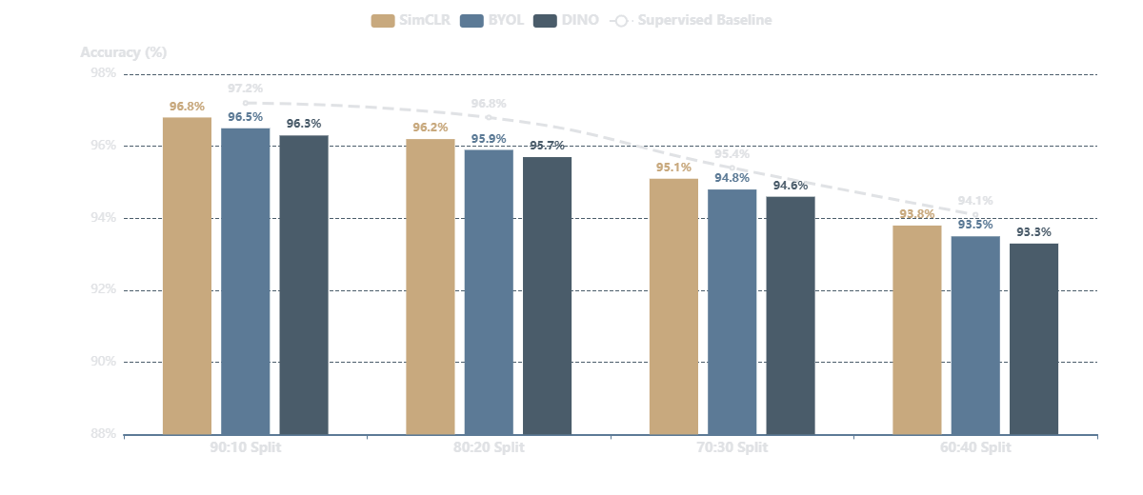
SSL RESULTS
Semi-Supervised Learning: Performance Analysis

Slide 9
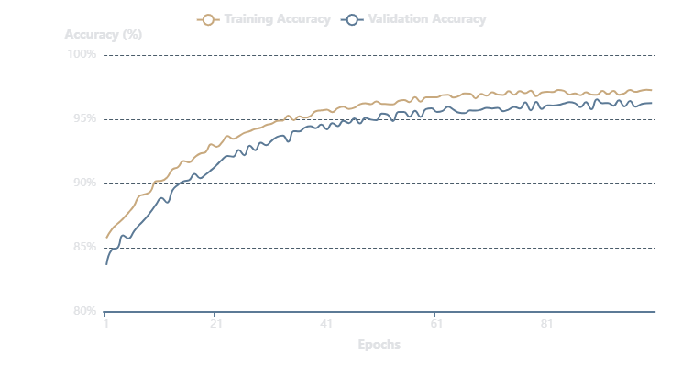
LEARNING CURVE ANALYSIS
Best SSL Model: SimCLR Performance
Training & Validation Learning Curve
Best Configuration
SSL Method
SimCLR
Best Train-Test Ratio
90:10 Split
Peak Accuracy
96.8%
Key Insights
Stable convergence after 400 epochs
Minimal overfitting observed
Strong generalization to test set

Slide 10
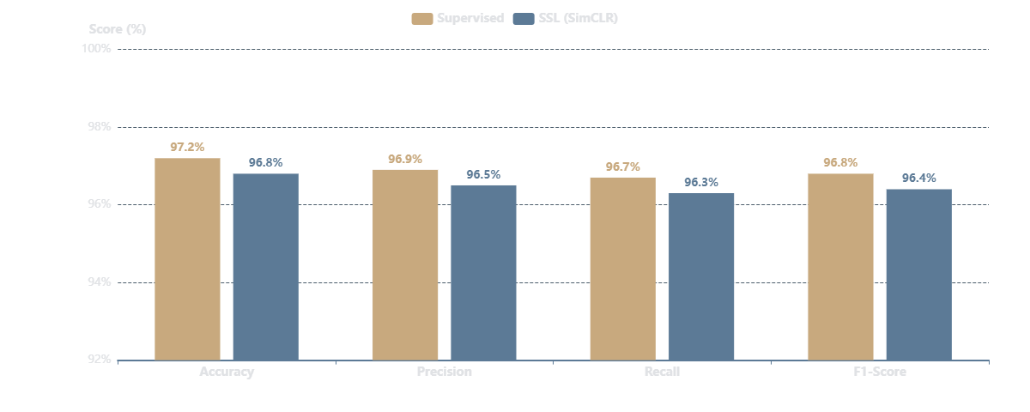
HEAD-TO-HEAD COMPARISON
Best Supervised vs Best SSL Model
97.2%
96.8%
0.4%
Limited
Supervised (90:10)
SSL SimCLR (90:10)
Accuracy Gap
SSL Data Need

Slide 11
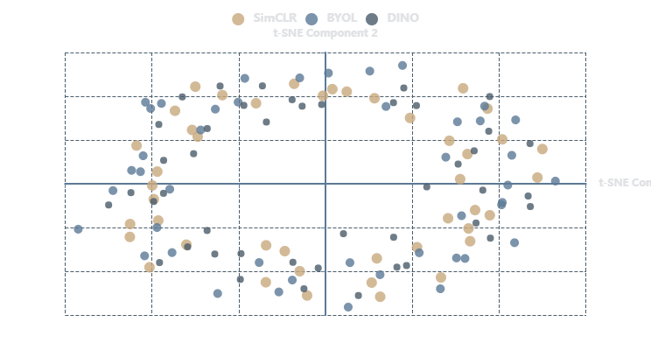
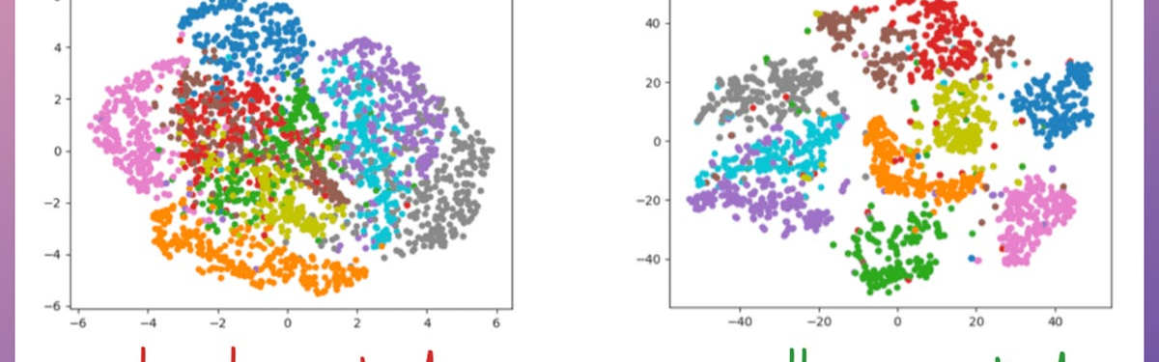
FEATURE SPACE ANALYSIS
t-SNE Visualization: SSL Method Comparison
2D Embedding Visualization
t-SNE Parameters
Perplexity:
30
Learning Rate:
200
Iterations:
1000
Components:
2D
Cluster Quality Analysis
SimCLR: Well-separated clusters
BYOL: Good class discrimination
DINO: Moderate separation
44 classes partially overlapping
t-SNE cluster separation example

Slide 12
PROJECT SUMMARY
Conclusions & Future Directions
Key Findings
Future Work
Supervised Learning Excellence
Achieved 97.2% accuracy with 90:10 split, demonstrating strong performance with sufficient labeled data
Advanced SSL Frameworks
Explore BYOL, DINO, SwAV, and Barlow Twins for potentially better performance
SSL Competitive Performance
SimCLR reached 96.8% accuracy, only 0.4% behind supervised, with minimal labeled data requirements
Dataset Expansion
Optimal Train-Test Ratio
Increase dataset size and diversity to improve model generalization
90:10 split consistently produced best results across both supervised and SSL methods
Meaningful Representations
Clinical Validation
t-SNE visualizations confirm SSL learns discriminative features with well-separated clusters
Validate models in real clinical settings with radiologist feedback
Model Interpretability
Implement attention mechanisms and Grad-CAM for explainable AI
Clinical Impact
Semi-supervised learning shows promise for medical image classification with limited labeled data, potentially reducing annotation burden while maintaining diagnostic accuracy.

